Slide 1

Artificial Intelligence Technologies
Search Techniques & Games III
By Hu Wang

Slide 2
Genetic Algorithm

Slide 3
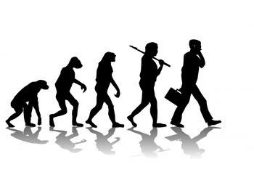
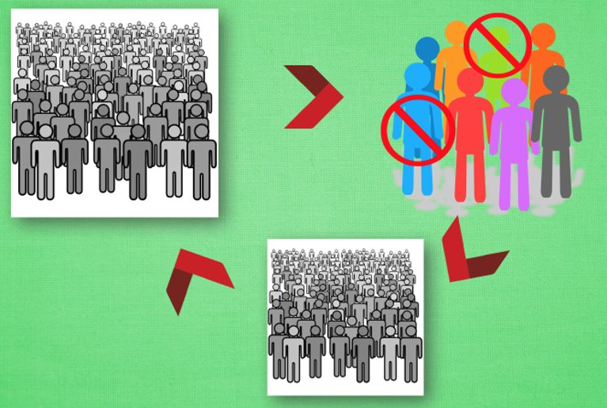
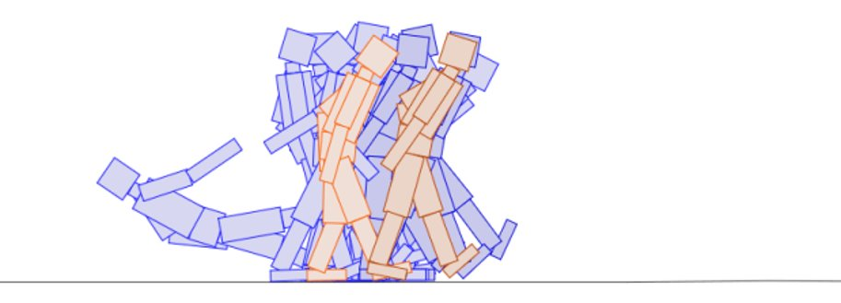
Evolutionary Algorithm

Slide 4
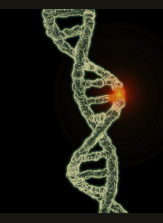
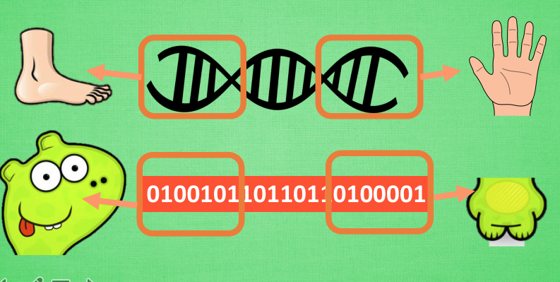
Genetic Algorithms

Slide 5
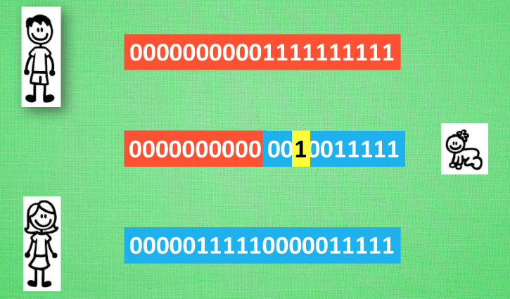
Genetic Algorithms

Slide 6
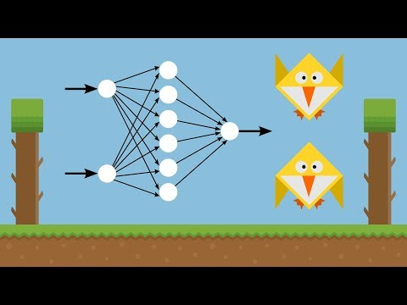
Genetic Algorithms --- Playing Games
https://www.youtube.com/watch?v=aeWmdojEJf0

Slide 7
Warning of Programming

Slide 8
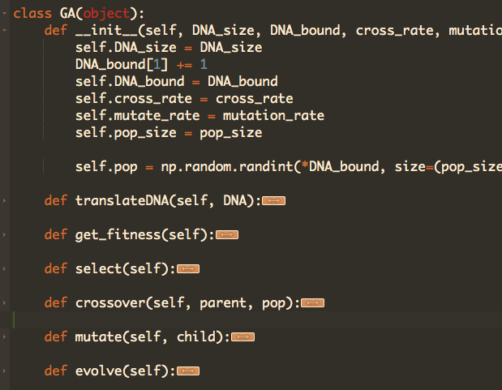
Genetic Algorithms

Slide 9
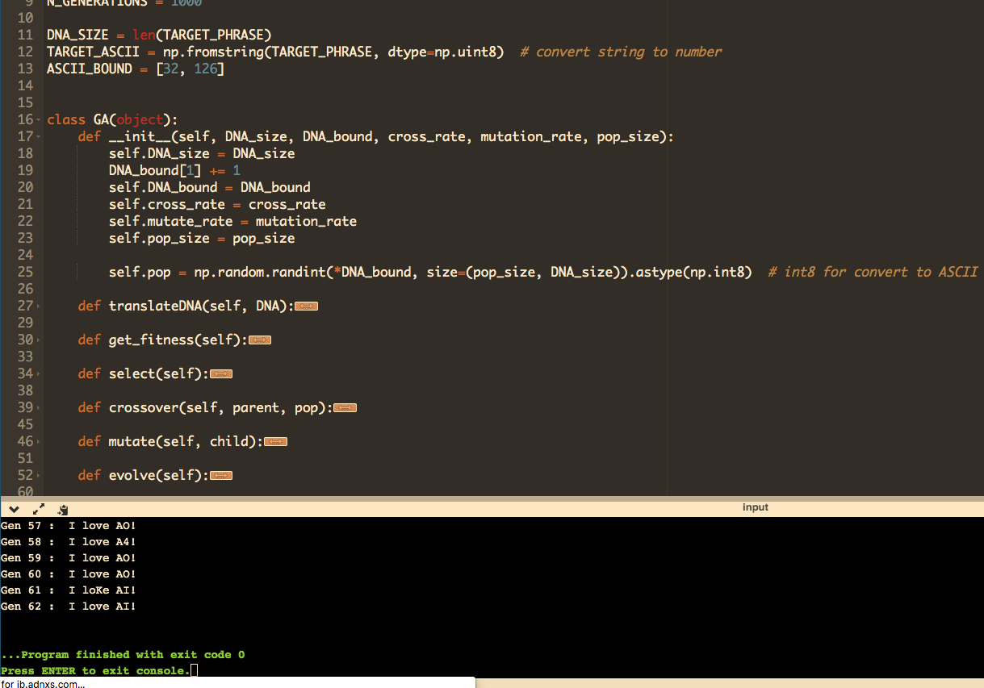
Genetic Algorithms

Slide 10
Demo

Slide 11
Dynamic Programming

Slide 12

DP --- Have a think
Suppose the currency in the cash drawer is only 11 cents, 5 cents and 1 cent coins. If you are looking for coins for 15 cents to customers, how can you arrange them?
Could this problem be solved by Greedy Algorithms?

Slide 13
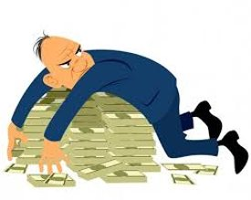
DP --- A Familiar Example
Suppose the currency in the cash drawer is only 11 cents, 5 cents and 1 cent coins. If you are looking for coins for 15 cents to customers, how can you arrange them?
Greedy:
15=1×11+4×1 (5 notes)

Slide 14
DP --- A Familiar Example
Suppose the currency in the cash drawer is only 11 cents, 5 cents and 1 cent coins. If you are looking for coins for 15 cents to customers, how can you arrange them?
Greedy (short-sighted):
15=1×11+4×1 (5 notes)
Actually you could:
15=3×5 (3 notes)

Slide 15
DP --- A Familiar Example
Analysis
If we divide the problem into:
If current money=15, and we choose 11. So the remining money would be (15-11=) 4.
If current money=15, and we choose 5. So the remining money would be (15-5=) 10.

Slide 16
DP --- A Familiar Example
Analysis
If we divide the problem into:
If current money=15, and we choose 11. So the remining money would be (15-11=) 4.
If current money=15, and we choose 5. So the remining money would be (15-5=) 10.
So we are facing a pattern: f(n) represents the least coins are required for money n.
If we choose 11, cost = f(4) + 1 = 4 + 1= 5
If we choose 5, cost = f(10) + 1 = 2 + 1 = 3

Slide 17
DP --- A Familiar Example
Now, we could make our decision
If current money=15, we choose the least coin number
If we choose 11, cost = f(4) + 1 = 4 + 1= 5
If we choose 5, cost = f(10) + 1 = 2 + 1 = 3
If we choose 1, cost = f(14) + 1 = 4 + 1 = 5

Slide 18
DP --- A Familiar Example
Now, we could make our decision
If current money=15, we choose the least coin number
If we choose 11, cost = f(4) + 1 = 4 + 1= 5
If we choose 5, cost = f(10) + 1 = 2 + 1 = 3
If we choose 1, cost = f(14) + 1 = 4 + 1 = 5
So we could draw a conclusion: f(n) is only related to f(n-11), f(n-5) and f(n-1)
f(n) = min{f(n-11), f(n-5), f(n-1)} + 1

Slide 19
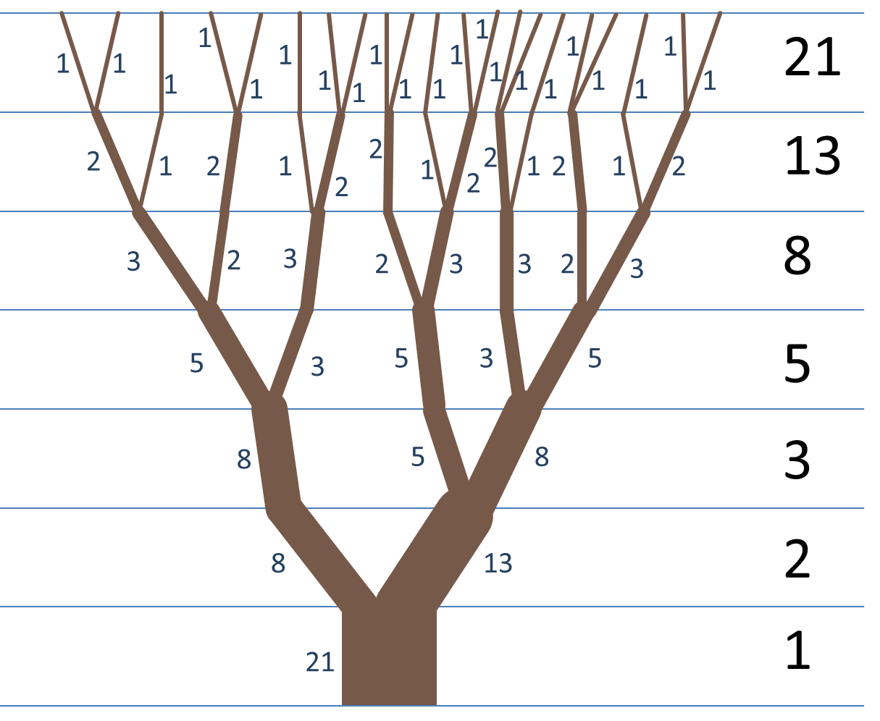
DP --- Fibonacci Sequence

Slide 20
Warning of Programming

Slide 21
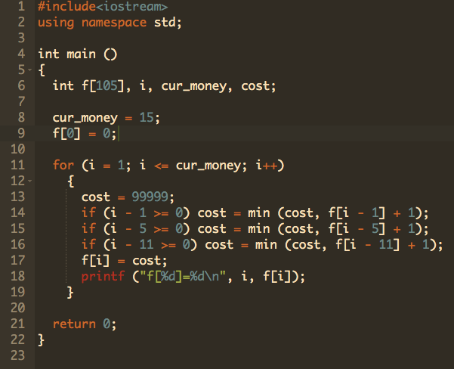
DP --- A Familiar Example

Slide 22
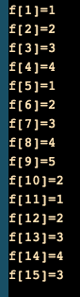
DP --- A Familiar Example

Slide 23
Demo

Slide 24
Game Theory

Slide 25
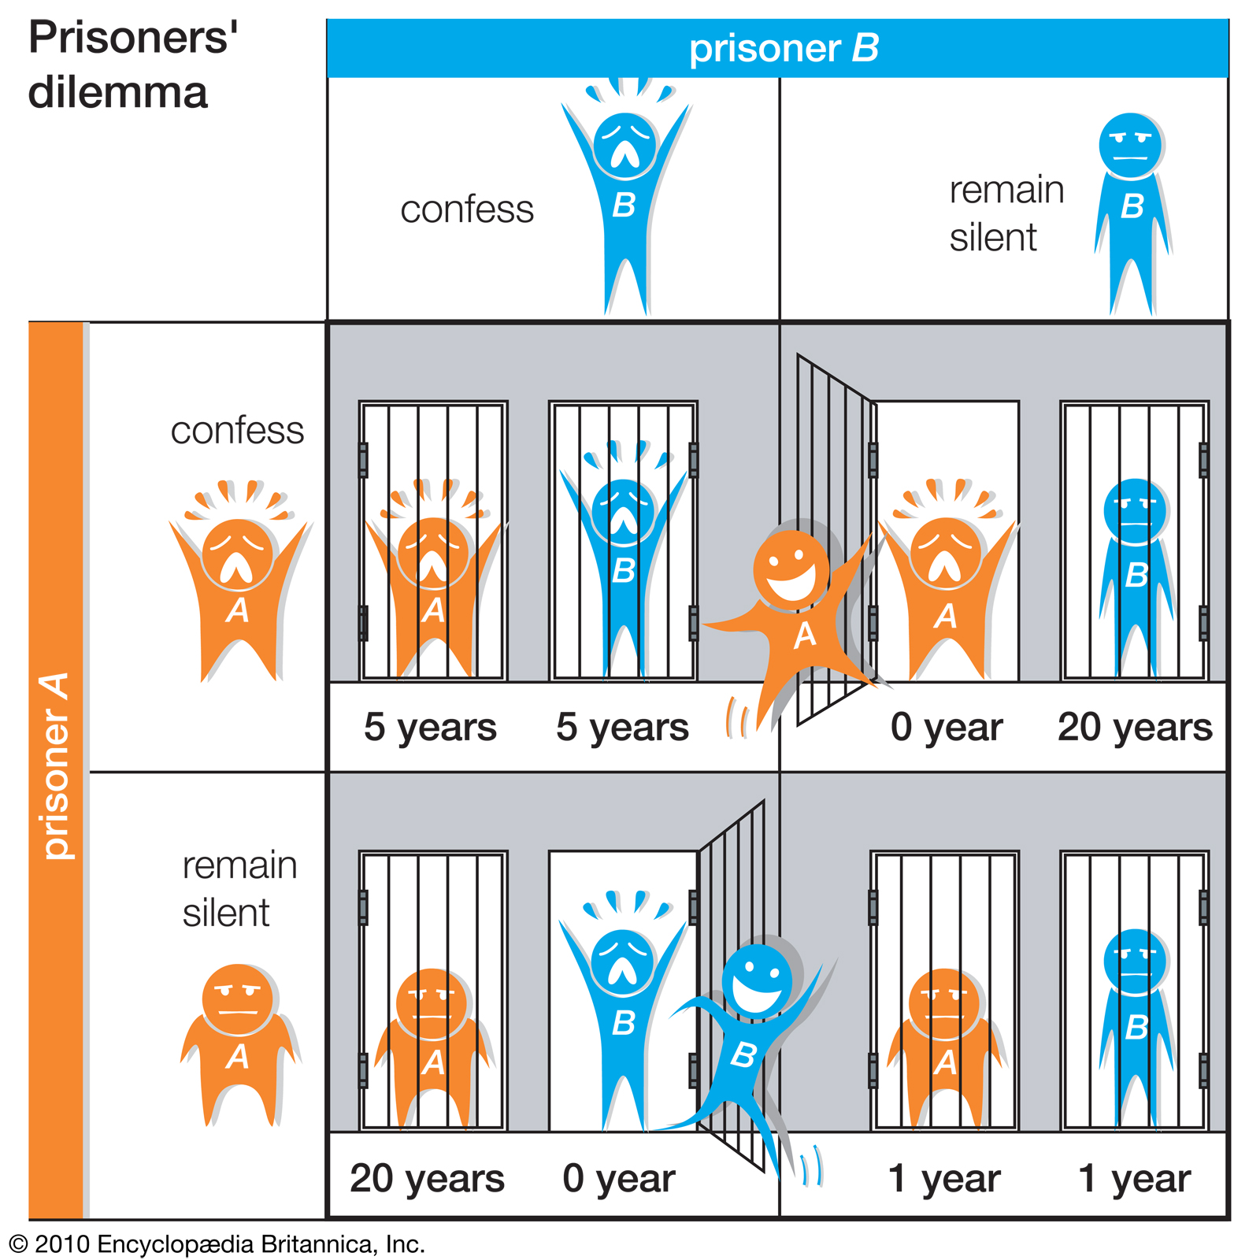
Game Theory --- Nash Equilibrium
https://www.britannica.com/science/game-theory/The-prisoners-dilemma

Slide 26
Game Theory --- Have a think
From 0-100, choose one integer.
WIN, if this number is less than 1/3 of average number chosen by your classmates

Slide 27
Game Theory --- Nash Equilibrium
From 0-100, choose one integer.
WIN, if this number is less than 1/3 of average number chosen by your classmates
The answer is 0!

Slide 28
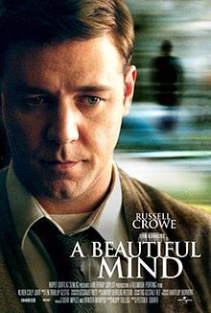
Game Theory --- Nash Equilibrium
From 0-100, choose one integer.
WIN, if this number is less than 1/3 of average number chosen by your classmates
The answer is 0!

Slide 29
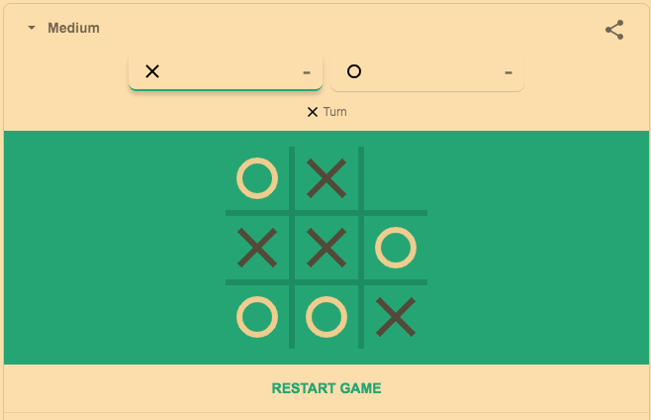
Tic Tac Toe

Slide 30
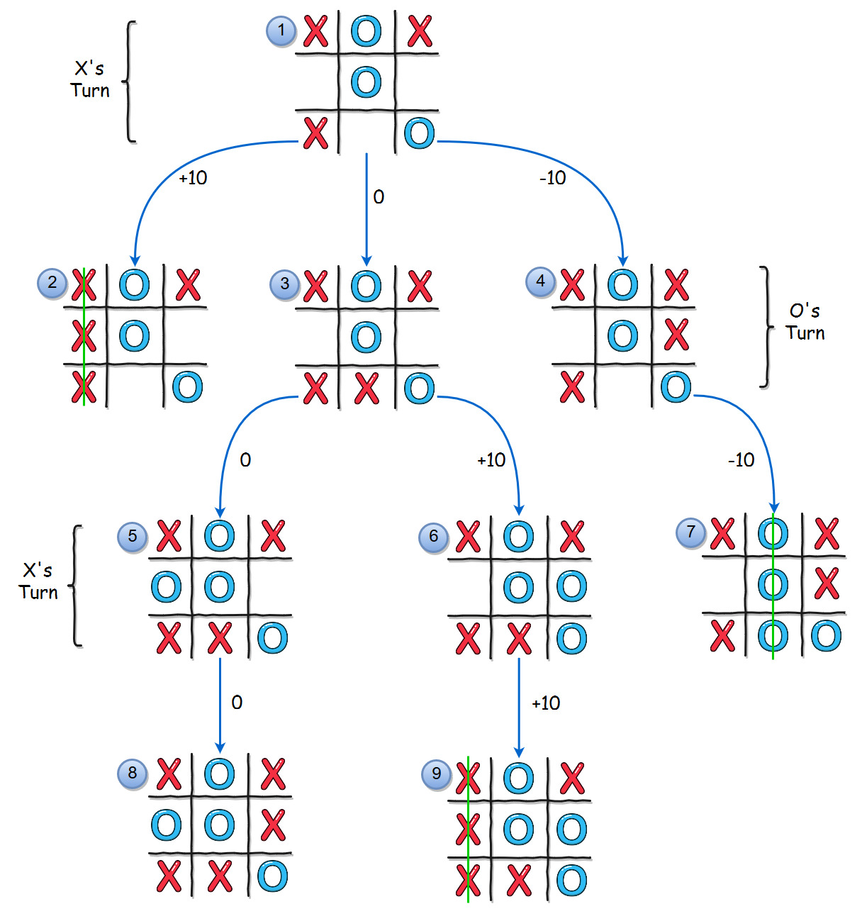
Tic Tac Toe

Slide 31
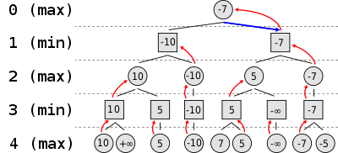
Tic Tac Toe --- Max-min

Slide 32

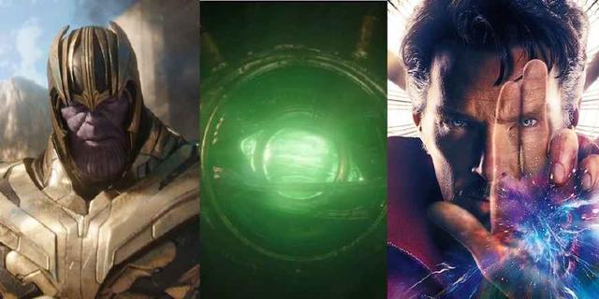
Recursion
Spoiler alert!

Slide 33
Reinforcement Learning

Slide 34


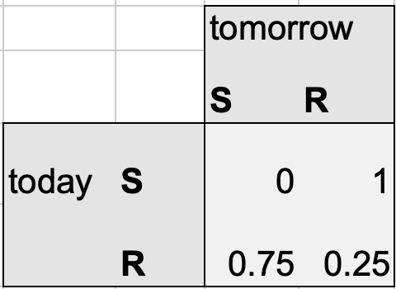
Markov process
https://towardsdatascience.com/predicting-the-weather-with-markov-chains-a34735f0c4df

Slide 35
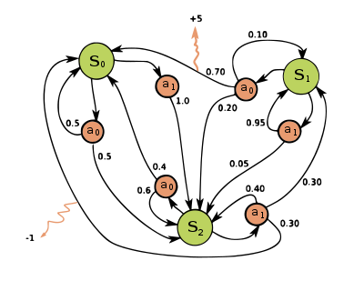
Markov decision process
https://setosa.io/ev/markov-chains/

Slide 36
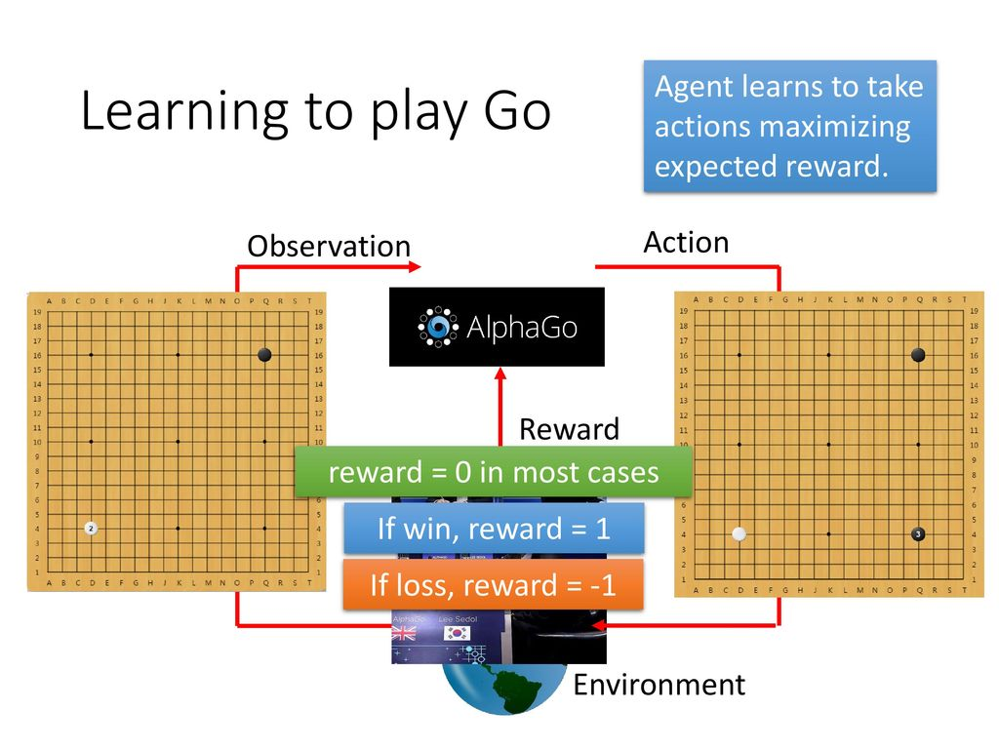

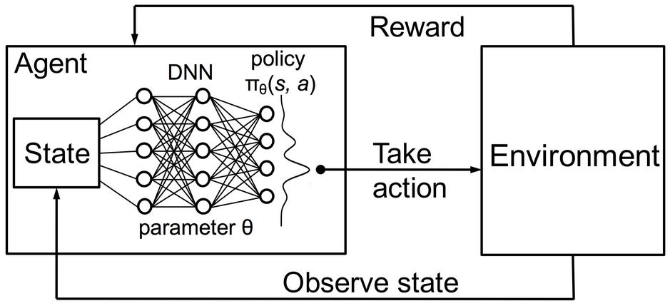
RL algorithms Definition
Objective: Agents take actions according to observation of an environment to maximize cumulative reward
Likes a human learns a task: observing by eyes ---> judging by brain ---> taking actions by hands

Slide 37
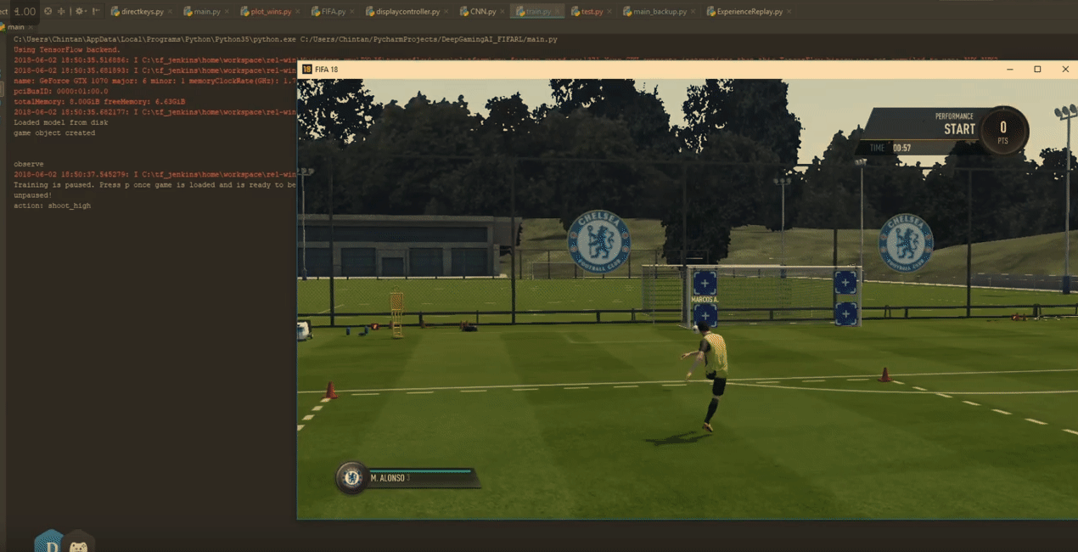
Application: Playing FIFA Game
How to select the most suitable actions (move right/left/shoot) for each step to maximize the outcome score

Slide 38
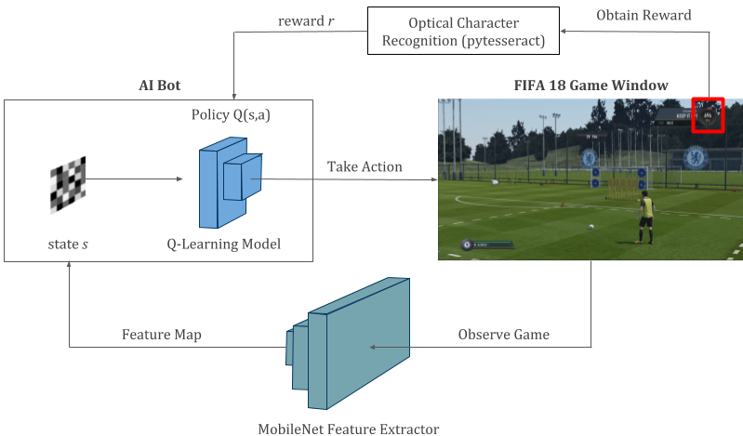
Application: Playing FIFA Game
Tailor DRL towards this task
Design states/action/reward tuples
States: current observations ---> Current screenshot
Actions: which kind of actions to select ---> move right/left/shoot
Rewards: the scores you will get at the end
The object: maximize outcome score

Slide 39
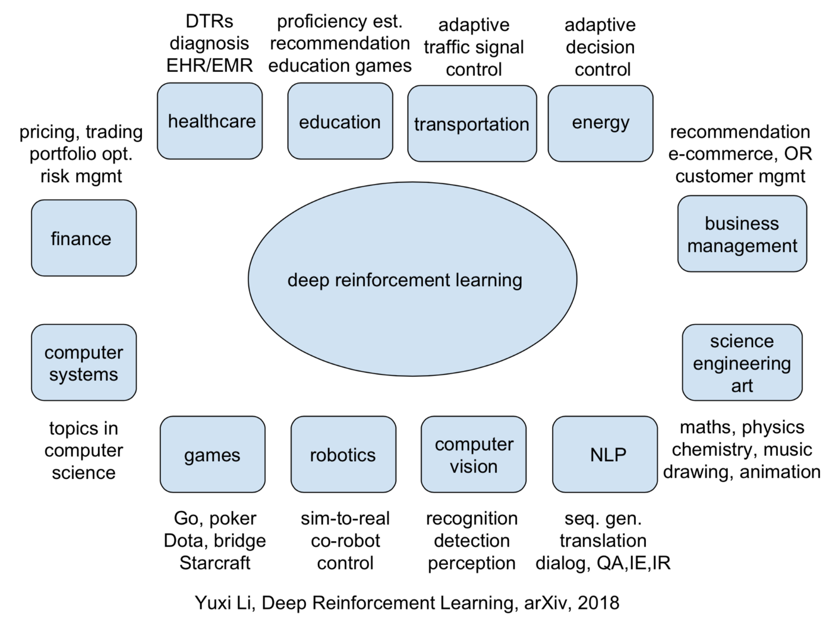
RL Application --- Overview

Slide 40
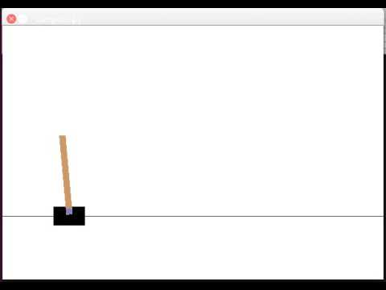
RL Algorithm --- Cartpole
https://www.youtube.com/watch?v=Qk61tqRrj0E

Slide 41
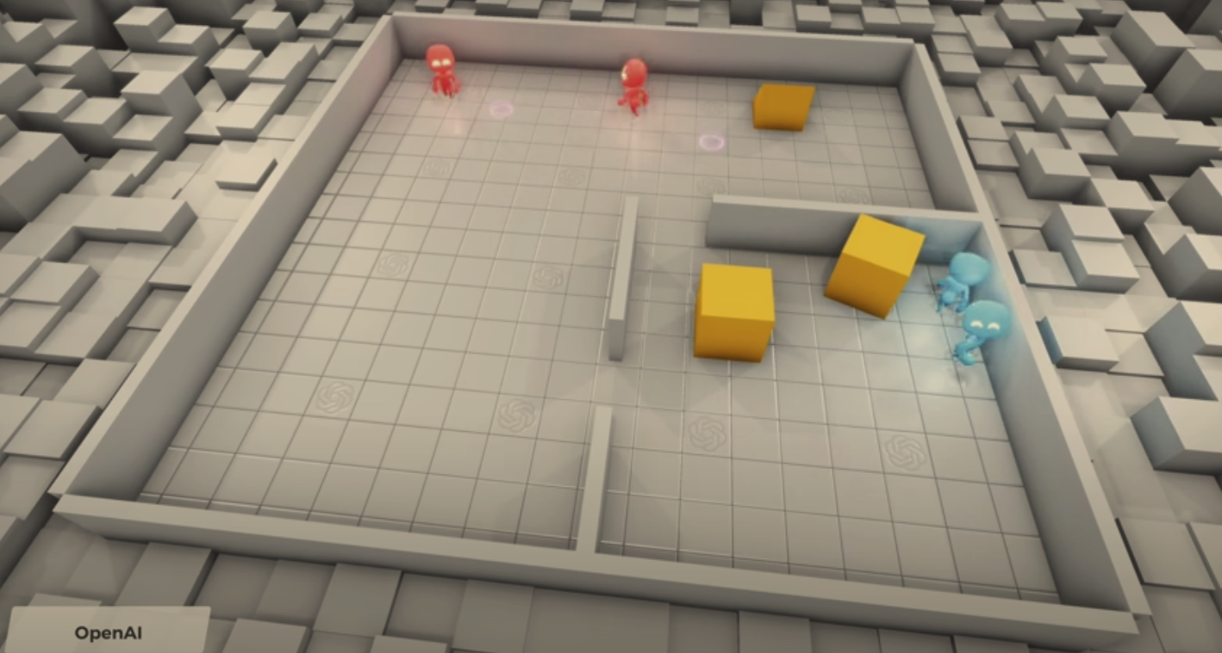
Hide and Seek

Slide 42
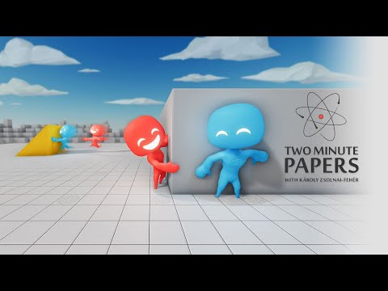
Hide and Seek
https://www.youtube.com/watch?v=Lu56xVlZ40M

Slide 43
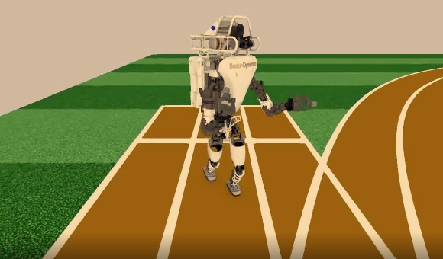
RL Algorithm --- PPO
https://openai.com/blog/openai-baselines-ppo/

Slide 44
Reference
Genetic Algorithm https://www.youtube.com/watch?v=1i8muvzZkPw
Dynamic Programming https://www.educative.io/courses/grokking-dynamic-programming-patterns-for-coding-interviews/m2G1pAq0OO0
David Silver, Reinforcement Learning Course, https://www.youtube.com/playlist?list=PLbWDNovNB5mqFBgq7i3MY6Ui4zudcvNFJ

